Slide 1
BHARTI INFOTECH AND SERVICES
Bilaspur , Chhattisgarh
Introduction to AC – DC motor

Slide 2
What is an Electric Motor?
Electromechanical device that converts electrical energy to mechanical energy
Mechanical energy used to e.g.
Rotate pump impeller, fan, blower
Drive compressors
Lift materials
Motors in industry: 70% of
electrical load

Slide 3
Classification of Motors
Electric Motors
Alternating Current (AC) Motors
Direct Current (DC) Motors
Synchronous
Induction
Separately Excited
Self Excited
Single-Phase
Three-Phase
Series
Compound
Shunt

Slide 4
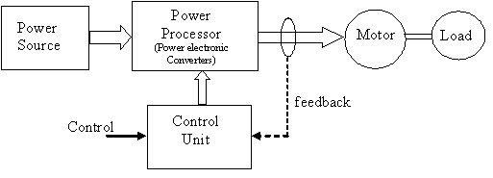
Modern electric drives system
5.AC source
6.DC source
1.Electric Motor
DC motors
AC motors
2. Loads
3. Power Converter
- Rectifiers (AC-DC)
- Choppers (DC-DC)
- Inverters (DC-AC)
- Cycloconverters (AC-AC)
4. Controller - Feedback/ closed loop control
Small
Efficient
Flexible

Slide 5
DC motors
Direct current (dc) motors have variable characteristics and are used extensively in variable-speed drives.
DC motors can provide a high starting torque and it is also possible to obtain speed control over a wide range.
The methods of speed control are normally simpler and less expensive than those of AC drives.
DC motors play a significant role in modern industrial drives.
Both series and separately excited DC motors are normally used in variable-speed drives, but series motors are traditionally employed for traction applications.
Due to commutators, DC motors are not suitable for very high speed applications and require more maintenance than do AC motors.
With the recent advancements in power conversions, control techniques, and microcomputers, the ac motor drives are becoming increasingly competitive with DC motor drives.
DC drives can be classified, in general, into three types:
1. Single-phase drives
2. Three-phase drives
3. DC-DC converter drives

Slide 6
AC Motor
Ac motors exhibit highly coupled, nonlinear, and multivariable structures as opposed to much simpler decoupled structures of separately excited dc motors.
The control of ac drives generally requires complex control algorithms that can be performed by microprocessors or microcomputers along with fast-switching power converters.
The ac motors have a number of advantages; they are lightweight (20 to 40% lighter than equivalent dc motors), are inexpensive, and have low maintenance compared with dc motors.
They require control of frequency, voltage, and current for variable-speed applications.
The power converters, inverters, and ac voltage controllers can control the frequency, voltage, or current to meet the drive requirements.
There are two types of ac drives:
Induction motor drives
Synchronous motor drives

Slide 7
Overview of AC and DC drives
Before semiconductor devices were introduced (<1950)
AC motors for fixed speed applications
DC motors for variable speed applications
After semiconductor devices were introduced (1950s)
Variable frequency sources available – AC motors in variable speed applications
Coupling between flux and torque control
Application limited to medium performance applications – fans, blowers, compressors – scalar control
High performance applications dominated by DC motors – tractions, elevators, servos, etc

Slide 8
DC motors: Regular maintenance, heavy, expensive, speed limit
Easy control, decouple control of torque and flux
AC motors: Less maintenance, light, less expensive, high speed
Coupling between torque and flux – variable spatial angle between rotor and stator flux
Type of AC motors
AC motors can be divided into :
series,
synchronous, and
induction motors

Slide 9
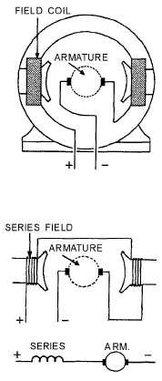
Series AC motors
Applications …
Series motors are used for driving fans, electric drills, and other small appliances.
Flexibility …
Can be operated from DC source
A series ac motor is the same electrically as a dc series motor.
Based on picture, by using the left- hand rule for the polarity of coils. You can see that the instantaneous magnetic polarities of the armature and field oppose each other, and motor action results.
Series AC motor

Slide 10
ROTATING MAGNETIC FIELDS
The principle of rotating magnetic fields is the key to the operation of most ac motors.
Both synchronous and induction types of motors rely on rotating magnetic fields in their stators to cause their rotors to turn.
The idea is simple. A magnetic field in a stator can be made to rotate electrically, around and around. Another magnetic field in the rotor can be made to chase it by being attracted and repelled by the stator field.
Because the rotor is free to turn, it follows the rotating magnetic field in the stator.

Slide 11
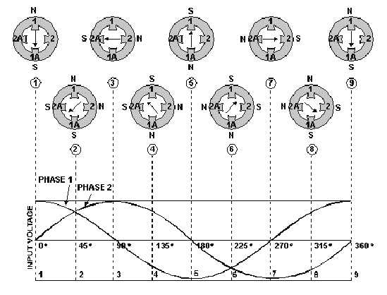
Two-phase rotating field …
Figure 4.3

Slide 12
The waveforms in figure 4-3 are of the two input phases, displaced 90º because of the way they were generated in a two-phase alternator. The waveforms are numbered to match their associated phase.
Although not shown in this figure, the windings for the poles 1-1A and 2-2A would be as shown in the previous figure. At position 1, the current flow and magnetic field in winding 1-1A is at maximum (because the phase voltage is maximum).
The current flow and magnetic field in winding 2-2A is zero (because the phase voltage is zero). The resultant magnetic field is therefore in the direction of the 1-1A axis.
At the 45-degree point (position 2), the resultant magnetic field lies midway between windings 1-1A and 2-2A. The coil currents and magnetic fields are equal in strength.
At 90º (position 3), the magnetic field in winding 1-1A is zero. The magnetic field in winding 2-2A is at maximum.
Now the resultant magnetic field lies along the axis of the 2-2A winding as shown. The resultant magnetic field has rotated clockwise through 90º to get from position 1 to position 3.

Slide 13
When the two-phase voltages have completed one full cycle (position 9), the resultant magnetic field has rotated through 360º .
Thus, by placing two windings at right angles to each other and exciting these windings with voltages 90º out of phase, a rotating magnetic field results.
Two-phase motors are rarely used except in special-purpose equipment. They are discussed here to aid in understanding rotating fields. You will, however, encounter many single-phase and three-phase motors.
THREE-PHASE ROTATING MAGNETIC FIELDS
The three-phase induction motor also operates on the principle of a rotating magnetic field.
Following Figure 4-4, views A-C show the individual windings for each phase. Figure 4-4, view D, shows how the three phases are tied together in a Y-connected stator. The dot in each diagram indicates the common point of the Y-connection.
individual phase windings are equally spaced around the stator. This places the windings 120º apart. The three-phase input voltage to the stator of figure 4-4 is shown in the graph of figure 4-5.

Slide 14
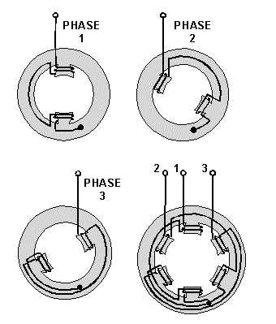
Use the left-hand rule for determining the electromagnetic polarity of the poles at any given instant. In applying the rule to the coils in figure 4-4, consider that current flows toward the terminal numbers for positive voltages, and away from the terminal numbers for negative voltages.
Figure 4-4.—Three-phase, Y-connected stator.

Slide 15
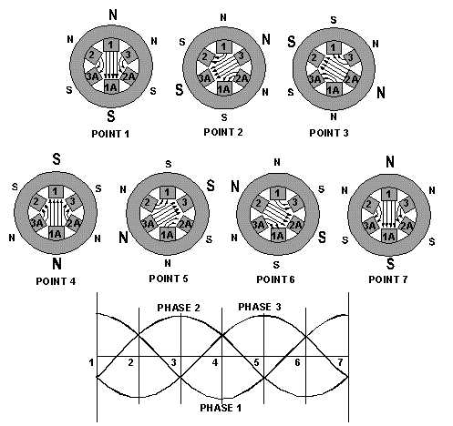
Figure 4-5.—Three-phase rotating-field polarities and input voltages.

Slide 16
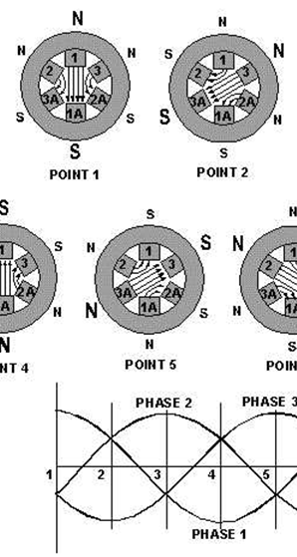
Analysis…
The results of this analysis are shown for voltage points 1 through 7 in figure 4-5.
At point 1, the magnetic field in coils 1-1A is maximum with polarities as shown.
At the same time, negative voltages are being felt in the 2-2A and 3-3A windings.
These create weaker magnetic fields, which tend to aid the 1-1A field. At point 2,
maximum negative voltage is being felt in the 3-3A windings. This creates
a strong magnetic field which, in turn, is aided by the weaker fields in 1-1A and 2-2A.
As each point on the voltage graph is analyzed, it can be seen that the resultant
magnetic field is rotating in a clockwise direction. When the three-phase voltage
completes one full cycle (point 7), the magnetic field has rotated through 360º .

Slide 17
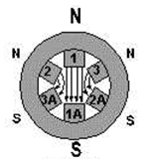
ROTOR BEHAVIOR IN A ROTATING FIELD
For purposes of explaining rotor movement, let's assume that we can place a bar magnet in the center of the stator diagrams of figure 4-5. We'll mount this magnet so that it is free to rotate in this area.
Let's also assume that the bar magnet is
aligned so that at point 1 its south pole is
opposite the large N of the stator field. You
can see that this alignment is natural. Unlike
poles attract, and the two fields are aligned
so that they are attracting. Now, go from
point 1 through point 7.
As before, the stator field rotates clockwise. The bar magnet, free to move, will follow the stator field, because the attraction between the two fields continues to exist.

